Slide 1
Binomial Heaps

Slide 2
Binomial trees and binomial heaps
A binomial heap is a collection of binomial trees
The binomial tree Bk is an ordered tree defined recursively.
The binomial tree B0 consists of a single node.
The binomial tree Bk consists of two binomial trees Bk−1 that are linked together.
The root of one is the leftmost child of the root of the other.
Figure shows the binomial trees B0 through B4.

Slide 3
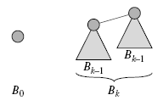
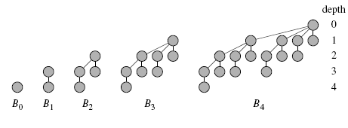
Binomial trees and binomial heaps
A binomial heap is a collection of binomial trees
The binomial tree Bk is an ordered tree defined recursively.
The binomial tree B0 consists of a single node.
The binomial tree Bk consists of two binomial trees Bk−1 that are linked together.
The root of one is the leftmost child of the root of the other.
Figure shows the binomial trees B0 through B4.

Slide 4
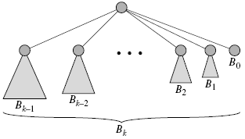
Binomial trees and binomial heaps
A binomial heap is a collection of binomial trees
The binomial tree Bk is an ordered tree defined recursively.
The binomial tree B0 consists of a single node.
The binomial tree Bk consists of two binomial trees Bk−1 that are linked together.
The root of one is the leftmost child of the root of the other.
Figure shows the binomial trees B0 through B4.

Slide 5
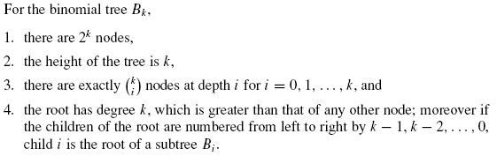
Properties of binomial trees

Slide 6
Properties of binomial trees

Slide 7
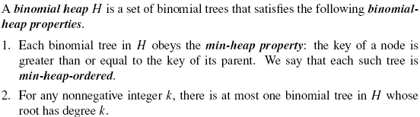
Binomial heaps

Slide 8
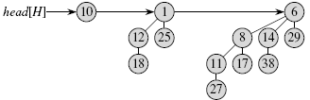
Representing binomial heaps
parent
Each node is represented by a structure like this
key
degree
child
sibling

Slide 9
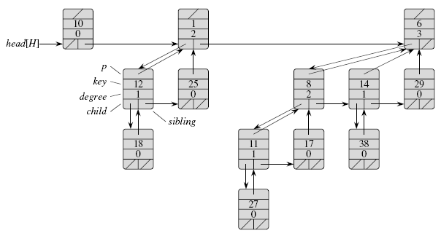
Representing binomial heaps

Slide 10

Operations on binomial heaps

Slide 11
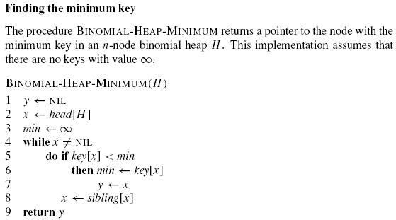
Finding the minimum key
Complexity: ?

Slide 12
Finding the minimum key
Complexity: Because there are at most lg n + 1 roots to check, the running time of BINOMIAL-HEAP-MINIMUM is O(lg n).

Slide 13
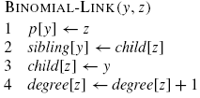
Uniting two binomial heaps
The following procedure links the Bk−1 tree rooted at node y
to the Bk−1 tree rooted at node z; that is, it makes z the
parent of y. Node z thus becomes the root of a Bk tree in O(1).time
y
z
y
z
B_{k-1}
B_{k-1}
B_{k-1}
Link
B_{k-1}

Slide 14
Union of two Binomial Heap
BINOMIAL-HEAP-UNION(H1, H2) procedure unites binomial heaps H1 and H2, after uniting it return the resulting heap.
It destroys the representations of H1 and H2 in the process.
Besides BINOMIAL-LINK, the procedure uses an auxiliary procedure BINOMIALHEAP- MERGE that merges the root lists of H1 and H2 into a single linked list that is sorted by degree into monotonically increasing order.
The BINOMIAL-HEAPMERGE procedure works like merging procedure in merge Sort.

Slide 15
Union of two Binomial Heap
H₁, H₂
Union
H₁ ∪ H₂
H₁ =
H₂ =
First, simply merge the two root lists by root degree (like merge sort).
Remaining Problem: Can have two trees with the same root degree.

Slide 16
Union (Continued)
Union traverses the new root list like this:
prev-x
x
next-x
Depending on what x, next-x, and sibling[next-x] point to, Union
links trees with the same root degree.
Note: We may temporarily create three trees with the same root
degree.

Slide 17
Analogy
head[H₁]
12
7
15
head[H₂]
18
3
6
25
28
33
37
8
29
10
44
41
23
22
48
31
17
30
45
32
24
50
Union
55
prev-x
x
head[H]
12
3
6
18
15
7
37
29
10
44
Like binary addition:
1 1 1 (carries)
0 0 1 1 1
1 0 0 1 1
1 1 0 1 0
8
28
33
25
22
48
31
17
30
23
41
32
24
50
45
55

Slide 18
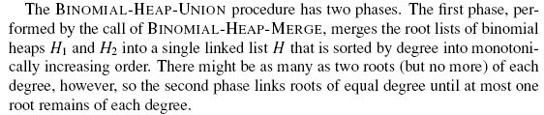
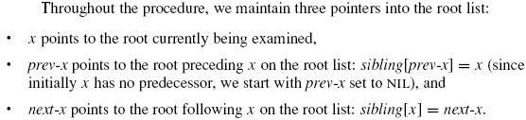
Union of two Binomial Heap

Slide 19
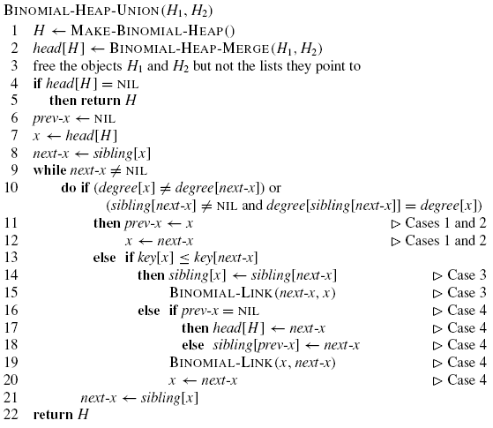
Algorithm

Slide 20
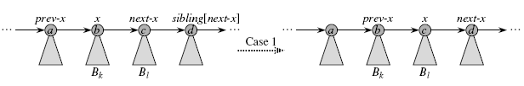
Different Cases in Union
Case 1: occurs when degree[x] ≠ degree[next-x], that is, when x is the root of a Bk-tree and next-x is the root of a Bl-tree for some l > k.
Here we don’t link x and next-x, so we simply march the pointers one position farther down the list.

Slide 21

Different Cases in Union
Case 2: Occurs when x is the first of three roots of equal degree, that is, when degree[x] = degree[next-x] = degree[sibling[next-x]] .
We handle this case in the same manner as case 1: we just march the pointers one position farther down the list.
The next iteration will execute either case 3 or case 4
to combine the second and third of the three equal-degree roots.

Slide 22
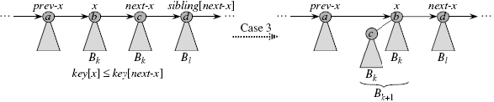
Different Cases in Union
Cases 3 and 4 occur when x is the first of two roots of equal degree, that is, when
degree[x] = degree[next-x] ≠ degree[sibling[next-x]] .
These cases may occur in any iteration, but one of them always occurs immediately following case 2. In cases 3 and 4.
Here we link x and next-x.
The two cases are distinguished by whether x or next-x has the smaller key, which determines the node that will be the root after the two are linked.

Slide 23
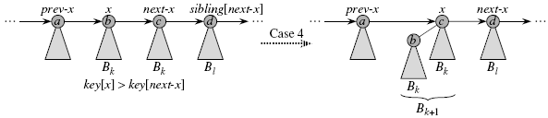
Different Cases in Union
Cases 3 and 4 occur when x is the first of two roots of equal degree, that is, when
degree[x] = degree[next-x] ≠ degree[sibling[next-x]] .
These cases may occur in any iteration, but one of them always occurs immediately following case 2. In cases 3 and 4.
Here we link x and next-x.
The two cases are distinguished by whether x or next-x has the smaller key, which determines the node that will be the root after the two are linked.

Slide 24
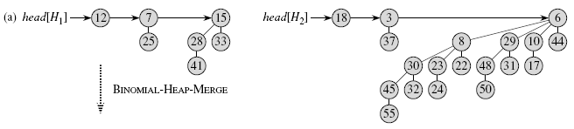
Example of Union of Binomial Heaps

Slide 25
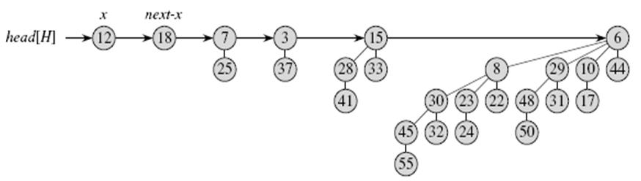
Example of Union of Binomial Heaps

Slide 26
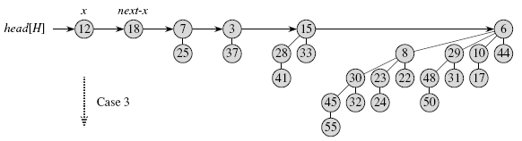
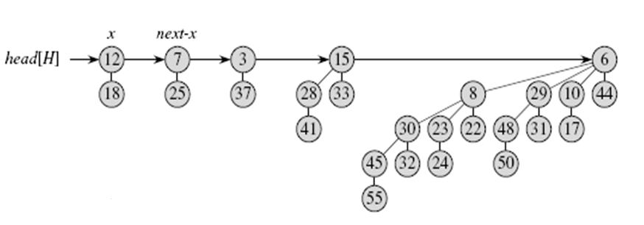
Example of Union of Binomial Heaps

Slide 27
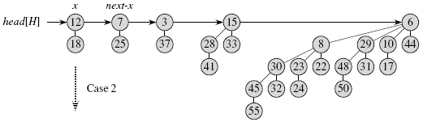
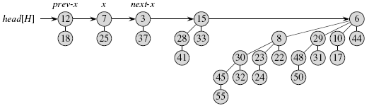
Example of Union of Binomial Heaps

Slide 28
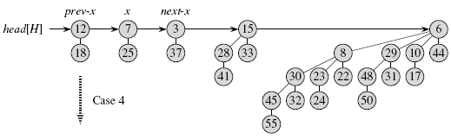
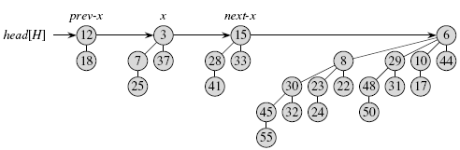
Example of Union of Binomial Heaps

Slide 29
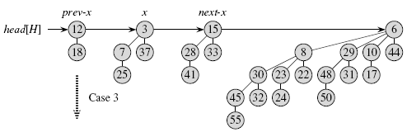
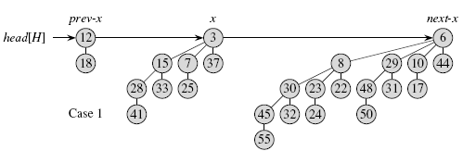
Example of Union of Binomial Heaps

Slide 30
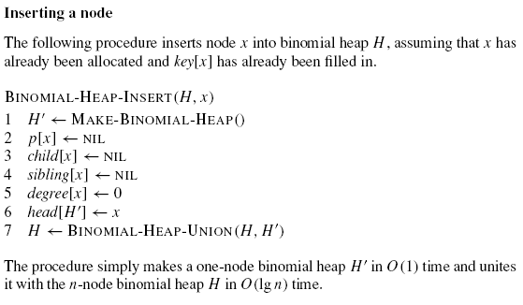
Inserting a node in Binomial

Slide 31
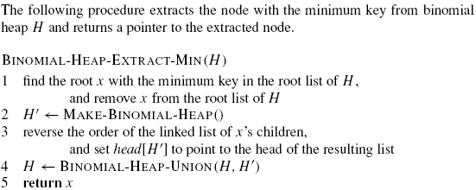
Extracting the node with minimum key

Slide 32
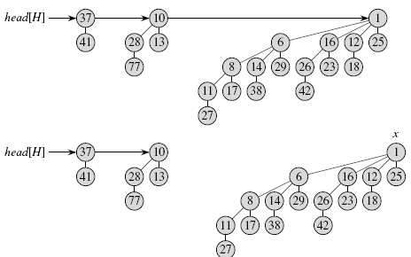
Extracting the node with minimum key: Example

Slide 33
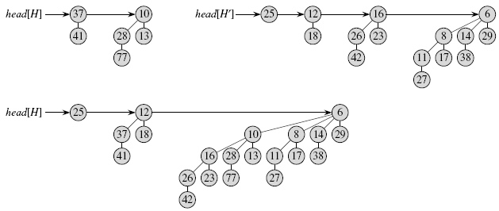
Extracting the node with minimum key: Example

Slide 34
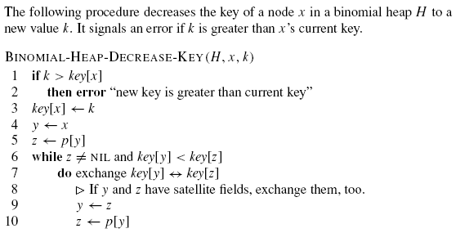
Decreasing a key

Slide 35
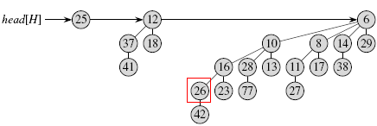
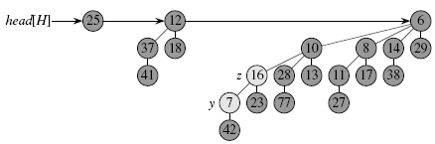
Decreasing a key: Example “26 is decreased to 7”

Slide 36
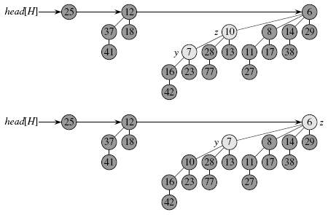
Decreasing a key: Example

Slide 37
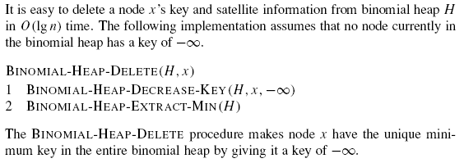
Deleting a key

